Slide 1
TRENDS IN B2B ECOMMERCE
LAST UPDATED: 09.06.2024
By Justin King
September 5, 2024

Slide 2

How to use this deck
The slide deck we've provided is designed for easy integration into your own presentations, with no logos or branding to worry about—just copy and paste directly into your deck. You don't need to credit the B2B E-Commerce Association; it's all yours to use freely.
Most slides already include citations either within the text or in the notes section, ensuring that you have the necessary references at your fingertips. We hope this resource proves valuable for your needs, and we'd love to hear your feedback on what additional content or information would be helpful.
Justin

Slide 3
Growth in B2B eCommerce
$17.9T
$12.2T
46.7%
Market Size
Market Size (2019)
Growth from 2019
Notes:
Source: Statista

Slide 4
B2B eCommerce Market Share (2023)
In 2023, B2B eCommerce accounted for about 14.1% of total B2B sales worldwide. This significant market share underscores the growing importance of digital platforms in B2B transactions.
Source: Statista.

Slide 5

Regional B2B eCommerce Market Sizes (2023)
$2.3T
$9T
$4T
U.S. B2B eCommerce
APAC B2B eCommerce
European B2B eCommerce

Slide 6
Digital Preferences in B2B eCommerce
75%
59%
33%
92%
Prefer no sales rep
Avoid sales managers
Want seller-free experience
Prefer digital interactions
Notes:
75% of B2B buyers prefer a sales experience without a representative.
Source: Gartner
59% of B2B tech buyers do not want to meet with sales managers.
Source: Gartner
33% of buyers want a seller-free experience.
Source: Gartner
92% of B2B buyers prefer virtual or digital sales interactions.
Source: Gartner

Slide 7
B2B eCommerce Growth vs. B2C eCommerce Growth
B2B eCommerce is poised for significant growth, expected to outpace B2C eCommerce by nearly 2:. The growth rate for B2B eCommerce is projected to be much higher, with B2B eCommerce anticipated to grow at a CAGR of 18.7% from 2021 to 2028. In contrast, B2C eCommerce growth is comparatively slower, which highlights the increasing shift towards B2B digital transactions.
This trend is supported by data from McKinsey & Company.

Slide 8




Digital Transformation Trends in B2B eCommerce
AI Adoption
Mobile Commerce
Self-Service Portals
Sales Automation
56% of B2B companies are using AI tools to enhance customer experience in eCommerce. Source: Accenture
45% of B2B buyers use mobile devices for product research and purchasing. Source: eMarketer
67% of B2B buyers prefer self-service options over speaking to a sales representative. Source: McKinsey & Company
59% of B2B companies have invested in sales automation tools to streamline operations. Source: HubSpot

Slide 9
Buyer’s Research Behavior
Independent Research
Digital Engagement
Content Consumption
Impact on Sales Interactions
77% of B2B buyers conduct their own research before speaking to a salesperson. This highlights the need for accessible online information.
67% of the buyer's journey is digital; only 5% involves direct interaction with sales personnel. This shows a shift towards digital channels for information.
68% of B2B buyers consume an average of 13 pieces of content before purchasing. Diverse content is essential for guiding decisions.
The extensive research behavior of buyers before engaging with salespeople requires sales teams to adapt to informed customers.
Research reports
Customer feedback surveys
Website analytics
Digital content strategy
Webinar recordings
SEO performance metrics
Content calendar
Blog posts
Whitepapers
Sales training programs
Customer journey maps
Engagement strategies
Notes:
75% of B2B buyers prefer a sales experience without a representative.
Source: Gartner
59% of B2B tech buyers do not want to meet with sales managers.
Source: Gartner
33% of buyers want a seller-free experience.
Source: Gartner
92% of B2B buyers prefer virtual or digital sales interactions.
Source: Gartner

Slide 10
73% of B2B buyers prefer purchasing through multiple channels.
In today's market, B2B buyers seek convenience by engaging with brands across multiple channels, including online, mobile, and in-store. This shift towards omnichannel purchasing enhances the buyer experience and allows businesses to meet customers wherever they are, providing a seamless shopping journey. Embracing this trend can lead to improved customer satisfaction and increased sales potential.

Slide 11
B2B Buyer Behavior Trends
86%
72%
80%
60%
Willing to Pay More
Trust Online Platforms
Prefer Online Orders
Speed & Ease Influence
Notes:
80% of B2B buyers prefer to place their orders online rather than through traditional channels. Source: McKinsey & Company
72% of B2B buyers say they trust online marketplaces and eCommerce platforms for their business purchases. Source: Accenture
60% of B2B buyers make their purchase decisions based on the speed of delivery and ease of transaction. Source: Forrester
86% of B2B buyers are willing to pay more for a better customer experience. Source: PwC

Slide 12
77% of buyers find their purchase process complex or difficult.
In today's marketplace, most B2B buyers face significant challenges in purchasing. 77% of buyers say their process is complex or difficult, often leading to longer timelines. 55% report an increase in purchase process length, due to factors like the need for detailed information, multiple stakeholders, & sophisticated technology requirements.
Notes:
77% of B2B buyers find their latest purchase process complex or difficult.
Source: Demand Gen Report
55% of B2B buyers report an increase in the length of their purchase process compared to a year ago.
Source: Demand Gen Report

Slide 13

High-Value Digital Transactions
Comfort with Online Purchases Above $50,000
Over 70% of B2B buyers are comfortable making online purchases exceeding $50,000, with 27% willing to spend over $500,000 digitally.
Notes:
Over 70% of B2B buyers are comfortable making purchases above $50,000 online.
Source: McKinsey
27% of B2B buyers are willing to spend over $500,000 in a digital self-service environment.
Source: McKinsey

Slide 14


Importance of Personalization
Demand for a Tailored Experience
Impact on Sales and Engagement
73% of buyers want a personalized, B2C-like experience.
79% consider the post-purchase experience as important as the product.
A tailored approach can lead to higher conversion rates.
Personalization enhances customer satisfaction and loyalty.
Personalization can increase customer retention rates significantly.
Buyers are more likely to engage with brands that offer tailored experiences.
Effective personalization strategies can drive repeat purchases.
Investing in personalization can lead to higher overall sales.
Notes:
73% of B2B buyers want a personalized, B2C-like experience.
Source: Accenture Interactive
79% of B2B buyers say the experience a company provides is as important as its products or services.
Source: Salesforce

Slide 15
75% of B2B companies invest in data analytics for customer insights.
Data analytics plays a crucial role in understanding customer behavior and preferences in B2B eCommerce. By investing in data analytics, these companies can tailor their offerings, enhance customer experiences, and make informed business decisions. As data-driven insights become more integral to strategic planning, the reliance on data analytics in B2B eCommerce will continue to grow.

Slide 16
Influence of Millennials in B2B Purchasing
Millennial Representation
44% of all B2B tech buyers are millennials, indicating their significant presence in the purchasing landscape.
Decision-Making Involvement
73% of millennials are involved in purchasing decisions, showcasing their influence on B2B buying processes.
Changing Dynamics
The growing millennial demographic is reshaping B2B purchasing, emphasizing the need for digital and personalized buying experiences.
Notes:
44% of all B2B tech buyers are millennials.
Source: Gartner
73% of millennials are involved in product or service purchasing decisions.
Source: Gartner

Slide 17
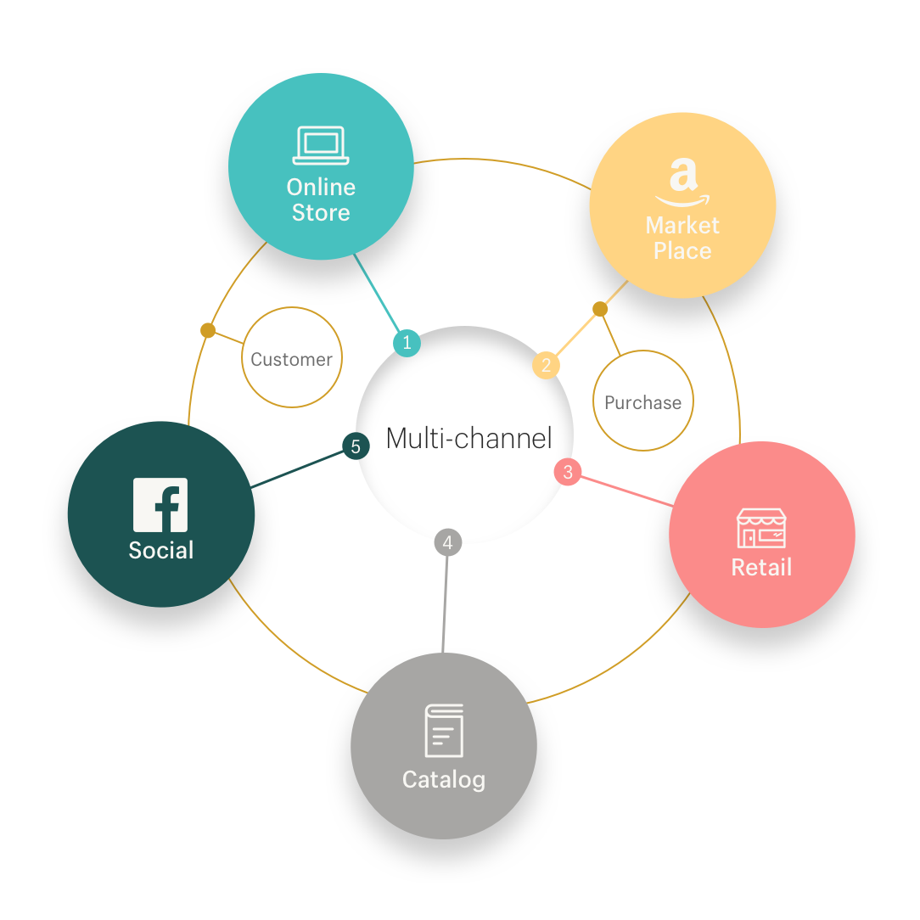
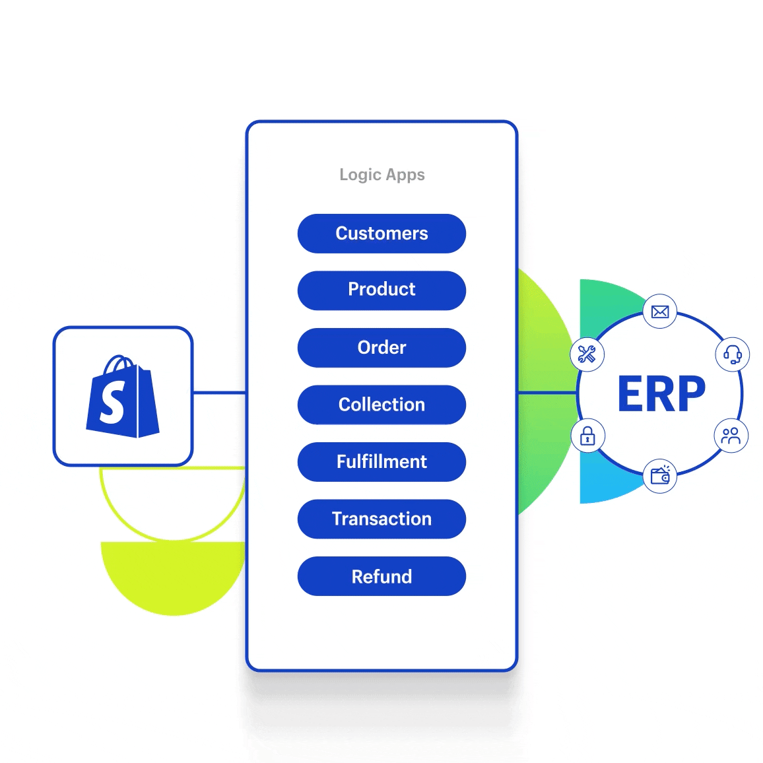
The Role of Omnichannel Strategies
Effectiveness of Omnichannel Models
94% of decision-makers find omnichannel models effective, enhancing customer engagement and satisfaction across multiple touchpoints.
Mobile Research and Purchasing
50% of research is conducted on mobile devices; 42% use mobile for purchasing, reflecting the shift towards mobile-first strategies in B2B.
Notes:
94% of B2B decision-makers find omnichannel sales models as effective or more effective than pre-pandemic methods.
Source: McKinsey
50% of B2B research is conducted on mobile devices, and 42% use mobile devices during the purchasing process.
Source: Boston Consulting Group

Slide 18
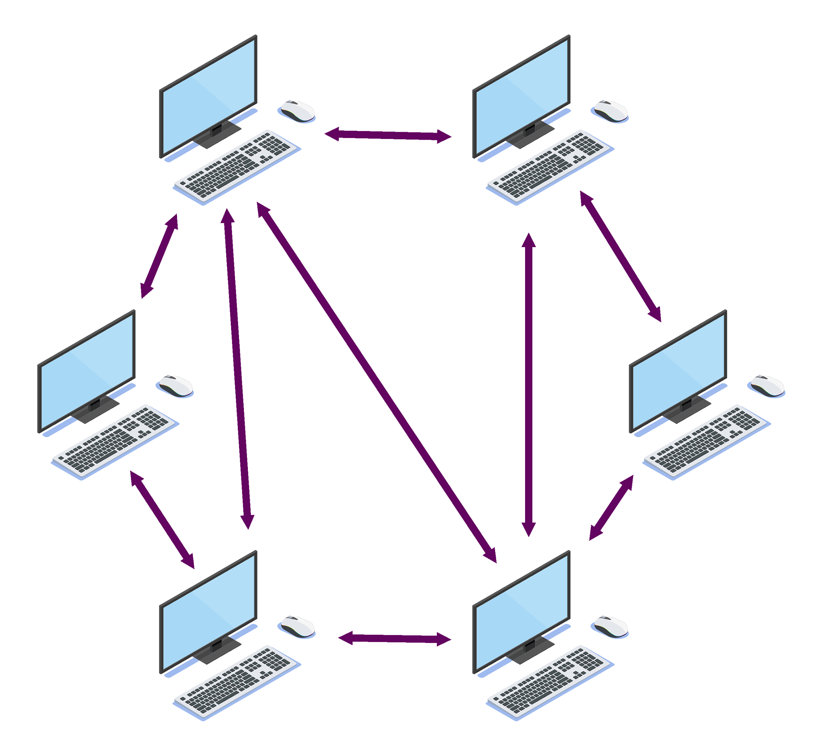
Trust and Referrals in B2B Sales
The Value of Peer Recommendations
74% of buyers rely on word-of-mouth referrals, indicating a strong preference for trust built through peer recommendations.
Peer referrals significantly influence purchasing decisions, as buyers are more likely to trust advice from colleagues and industry peers.
Building a network of satisfied customers can enhance credibility and lead to increased sales opportunities.
In B2B sales, trust is often established through shared experiences and recommendations, making it crucial for companies to foster positive relationships.
Source: Edelman and LinkedIn

Slide 19
B2B Market Size and Growth
$17.9 trillion
$2.3 trillion
$3.5 trillion
$9 trillion
Global B2B eCommerce market size
US market size (2023)
US market projection (2027)
APAC market size (2023)
Notes:
Global B2B eCommerce market size (2023): $17.9 trillion, growing from $12.2 trillion in 2019.
Source: Statista
US B2B eCommerce market size (2023): $2.3 trillion; projected to reach $3.5 trillion by 2027.
Source: Forrester
APAC B2B eCommerce market size (2023): $9 trillion.
Source: Statista
European B2B eCommerce market size (2023): $4 trillion.
Source: Statista

Slide 20
Digital Transformation Trends in B2B
Adoption of AI is transforming B2B interactions, enhancing personalization and efficiency in sales processes.
Mobile commerce is increasingly prevalent, with 50% of B2B research conducted on mobile devices, facilitating on-the-go decision-making.
Self-service portals are preferred by 67% of buyers, providing them with autonomy and control in their purchasing journey.
B2B marketplaces are expanding, offering diverse options for buyers and streamlining the purchasing process for businesses.

Slide 21




Challenges in B2B eCommerce
Data Security
Integration Complexity
Talent Shortages
High Costs
45% of companies identify data security as a significant barrier to digital success, as protecting sensitive information is paramount in B2B transactions.
40% of businesses face challenges with the complexity of integrating new digital solutions into existing systems, which can hinder operational efficiency.
48% of organizations report talent shortages as a major hurdle, making it difficult to find skilled personnel to drive digital transformation efforts.
55% cite the high costs of digital transformation as a barrier, impacting investment in necessary technologies and resources for B2B eCommerce.

Slide 22
Growth in Cross-Border B2B eCommerce
Cross-border B2B eCommerce transactions are expected to grow by 18% annually through 2027. This growth reflects the increasing globalization of trade and the rising demand for international suppliers and buyers in the B2B sector. Source: Statista.

Slide 23
AI-Powered Chatbots
58% of B2B companies are using AI-powered chatbots to handle customer inquiries and improve service efficiency. These chatbots automate responses, provide instant support, and enhance overall customer experience, allowing businesses to manage a higher volume of inquiries without the need for proportional increases in staff.

Slide 24
Customization of B2B Products
64% of B2B buyers expect their suppliers to provide tailored products and services, highlighting the growing demand for customization in B2B eCommerce. This expectation reflects the shift towards more personalized solutions that cater to specific business needs, enhancing customer satisfaction and loyalty. As such, suppliers that can offer customization are likely to gain a competitive advantage in the marketplace.

Slide 25
Real-Time Inventory Visibility
Real-time inventory visibility is crucial for B2B buyers when making purchasing decisions. A significant 73% of B2B buyers expect real-time inventory visibility to inform their choices, as it allows them to ensure product availability and streamline their purchasing process. This transparency helps mitigate potential disruptions and enhances overall customer satisfaction. Source: Gartner.

Slide 26
Demand for Flexible Payment Options
61% of B2B buyers want flexible payment options, including credit terms and installment plans. This demand reflects the shifting landscape in B2B eCommerce, where buyers are increasingly looking for payment solutions that align with their financial strategies and cash flow management needs. Offering these options can enhance customer satisfaction and loyalty, making it essential for B2B companies to adapt to this trend.

Slide 27
40% of B2B companies struggle with integrating eCommerce platforms with their ERP.
This complexity arises from the need to synchronize data, processes, and workflows between disparate systems, which can lead to inefficiencies and increased operational costs. Additionally, the lack of standardized protocols and the varying degrees of technological maturity among companies further complicate the integration process. These challenges can hinder the overall effectiveness of B2B eCommerce initiatives.

